Slide 1
Chronic Myeloid Leukemia
الدكتورة
وســمة العشاوي
اخصائية أمراض دم

Slide 2
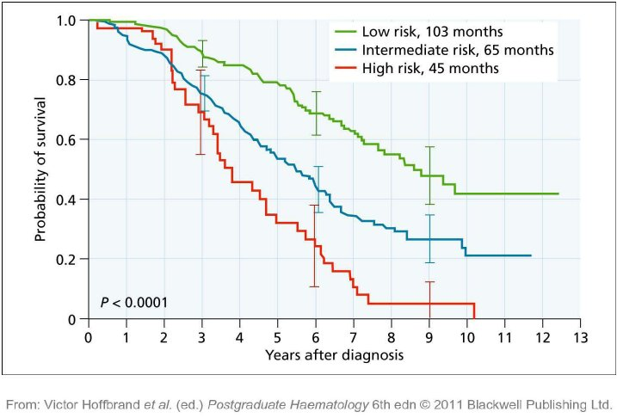
Chronic myeloid leukemia
‘ myeloproliferative neoplasm ’ classify tumors of the haemopoietic and lymphoid systems
chronic myeloid leukemia (CML) is the most common subtype

Slide 3
Chronic myeloid leukemia
Chronic myeloid leukemia clonal disease that results from an acquired genetic change in a
pluripotential haemopoietic stem cell
displaces normal haemopoiesis leads to a
greatly expanded total myeloid mass
Landmark
discovery of the Philadelphia (Ph.) chromosome in 1960
t(9;22)(q34;q11) translocation in 1973
Identification in the 1980s of the BCR –LAB

Slide 4
Chronic myeloid leukemia
Until the 1980s, CML was generally incurable
treated palliatively with radiotherapy and later with alkylating agents.
SCT
1998 tyrosine kinase inhibitor (TKI) imatinib mesylate complete cytogenetic response
and may expect substantial prolongation of survival
second - generation TKIs, dasatinib, nilotinib and bosutinib, may be more effective than imatinib.

Slide 5
Chronic myeloid leukemia
Epidemiology, a etiology and natural history
The incidence of CML worldwide. It occurs in about 1.0 – 1.5 per 100 000 of the population
CML is rare below the age of 20 years. the median age of onset is 50 – 60 years.
The incidence is slightly higher in males than in females.
The risk of developing CML is slightly but significantly
increased by exposure to high doses of irradiation.(atomic bomb –irradiation of ankylosing spondylitis and malignant diseases)
in general, almost all cases must be regarded as sporadic without identifi able predisposing factors
no familial predisposition, no definite association with HLA genotypes, No contributory infectious agent

Slide 6
Chronic myeloid leukemia
Clinically,
CML is classically a biphasic or triphasic disease that is usually diagnosed in the initial ‘ chronic ’ , ‘ indolent ’ or ‘ stable ’ phase.
before the diagnosis is established…..
It could be 5 – 10 years before the disease becomes clinically manifest
since the introduction of TKIs and today the majority of patients
may never progress beyond the chronic phase.
chronic phase used to last about 2 – 7 years for most patients who respond well
to TKIs, survival is likely to exceed 20 years
50% of the patients who fail
TKI treatment the chronic phase transforms unpredictably
more aggressive phase to as ‘ blastic crisis & transformation
Survival 3 – 9 months.

Slide 7
Chronic myeloid leukemia
Classification
Homogeneous disease characterized at diagnosis by:
splenomegaly, leukocytosis and the presence of the BCR – ABL1 fusion gene in all leukemic cells.
A minority of patients have less typical disease that may be classified as atypical CML, chronic myelomonocytic leukemia or chronic neutrophilic leukemia (CNL).
Children may have a disease referred to as juvenile chronic myelomonocytic leukemia.

Slide 8
Chronic myeloid leukemia
Staging
Sokal and colleagues in 1984 , is based on a formula that takes account of the patient ’ s age, blast cell percentage, spleen size and platelet count at diagnosis
patients who have a low leucocyte doubling time probably survive longer than those with more rapid doubling times.
a complete cytogenetic response to interferon Alfa or rapid reduction in BCR – ABL1 transcript numbers in patients starting treatment with imatinib are both good prognostic factors

Slide 9
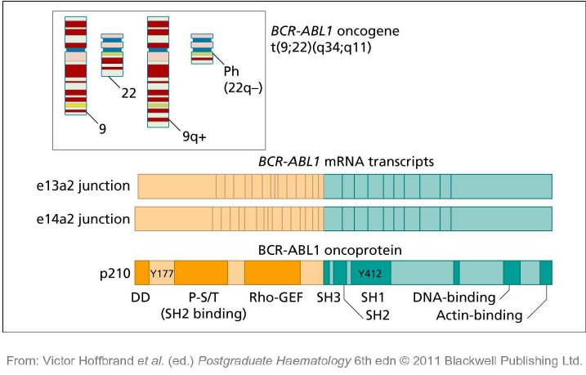
Chronic myeloid leukemia
Cytogenetics
The Philadelphia chromosome(22q–) acquired cytogenetic abnormality
as t(9;22)(q34;q11) present in all myeloid cell lineages some B cells
a very small proportion of T cells It is found in no other cells of the body

Slide 10
Chronic myeloid leukemia
Clinical features
splenomegaly, hemorrhage or anemia
almost 50% of patients as a result of routine blood tests
loss of energy Increased sweating, bruising or
unexplained bleeding from gums, intestine or urinary tract
Fever
lymphadenopathy are rare in chronic phase.
discomfort in the splenic area(splenic infarction)
blastic transformation(painful)
The liver may become very large fever, lymphadenopathy or very rarely lytic lesions of bone.

Slide 11
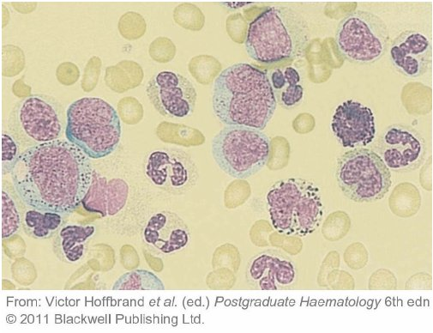
Chronic myeloid leukemia

Slide 12
Chronic myeloid leukemia
Criteria for distinguishing the chronic, accelerated
and blastic phases of CML based on proposals published by
WHO (2001).
Chronic phase
Ability to reduce spleen size and restore and maintain a ‘ normal ’
blood count with appropriate therapy
Accelerated phase (defined by one or more of the following features)
Blasts 10 – 19% of white blood cells in peripheral blood and/or of
nucleated bone marrow cells
Peripheral blood basophils ≥ 20%
Persistent thrombocytopenia ( < 100 × 10 9 /L) unrelated to
therapy, or persistent thrombocytosis ( > 1000 × 10 9 /L)
unresponsive to therapy
Increasing spleen size and increasing white blood cell count
unresponsive to therapy
Megakaryocyte proliferation in sheets or clusters in association
with marked reticulin or collagen fibrosis
Blastic phase (defined by one or more of the following features)
Blasts > 20% of peripheral blood leucocytes or of nucleated bone
marrow cells
Extramedullary blast proliferation
Large foci or clusters of blasts in the bone marrow biopsy

Slide 13
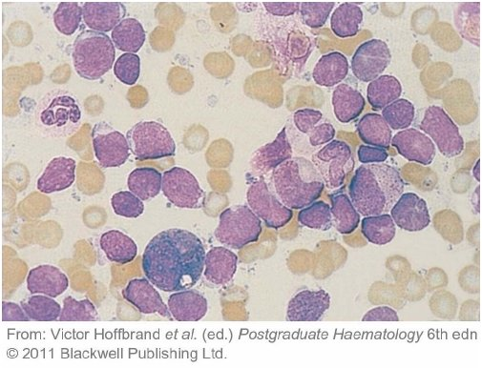
Chronic myeloid leukemia

Slide 14
Chronic myeloid leukemia
Management of chronic myeloid leukemia in chronic phase
changed very greatly in the last decade,
no urgency to start treatment immediately in
asymptomatic patients with leucocyte counts below 100 × 10 9 /L leucapheresis with cryopreservation of blood stem cells can be
performed before anti - leukemia treatment

Slide 15
Chronic myeloid leukemia
Imatinib mesylate
Imatinib mesylate (Glivec or Gleevec; previously known as STI571), a 2 - phenylaminopyrimidine compoundis an ABL1 tyrosine kinase inhibitor
that entered clinical trials in 1998.
orally at a dose of 400 mg daily,
600 mg or even 800 mg daily gives more rapid responses
Side - effects include nausea, headache, rashes, infraorbital oedema, bone pains and, sometimes, more generalized fluid retention.
Hepatotoxicity characterized by raised serum transaminases fatal cerebral oedema.
Neutropenia, Thrombocytopenia Phase III trial (the IRIS trial) designed to compare imatinib as a single agent with the combination of interferon alfa and cytarabine
74% of the patients treated with imatinib achieved complete cytogenetic remission compared with 14% of those in the control arm
event - free survival was 83%
and overall survival 88%.

Slide 16
Chronic myeloid leukemia
Table 27.3 Definitions of cytogenetic and molecular responses.
Cytogenetic response
Designation Percentage of Molecular response
Ph- positive ( BCR – ABL1 transcript
marrow numbers expressed on the
metaphase international scale)
Complete 0 Baseline, 100%
Partial 1 – 35 Cytogenetic response, ∼ 1%
Minor 36– 65 Major molecular response,0.1%
Minimal 66 – 95 Complete molecular response, ∼ 0.001%
None > 95

Slide 17
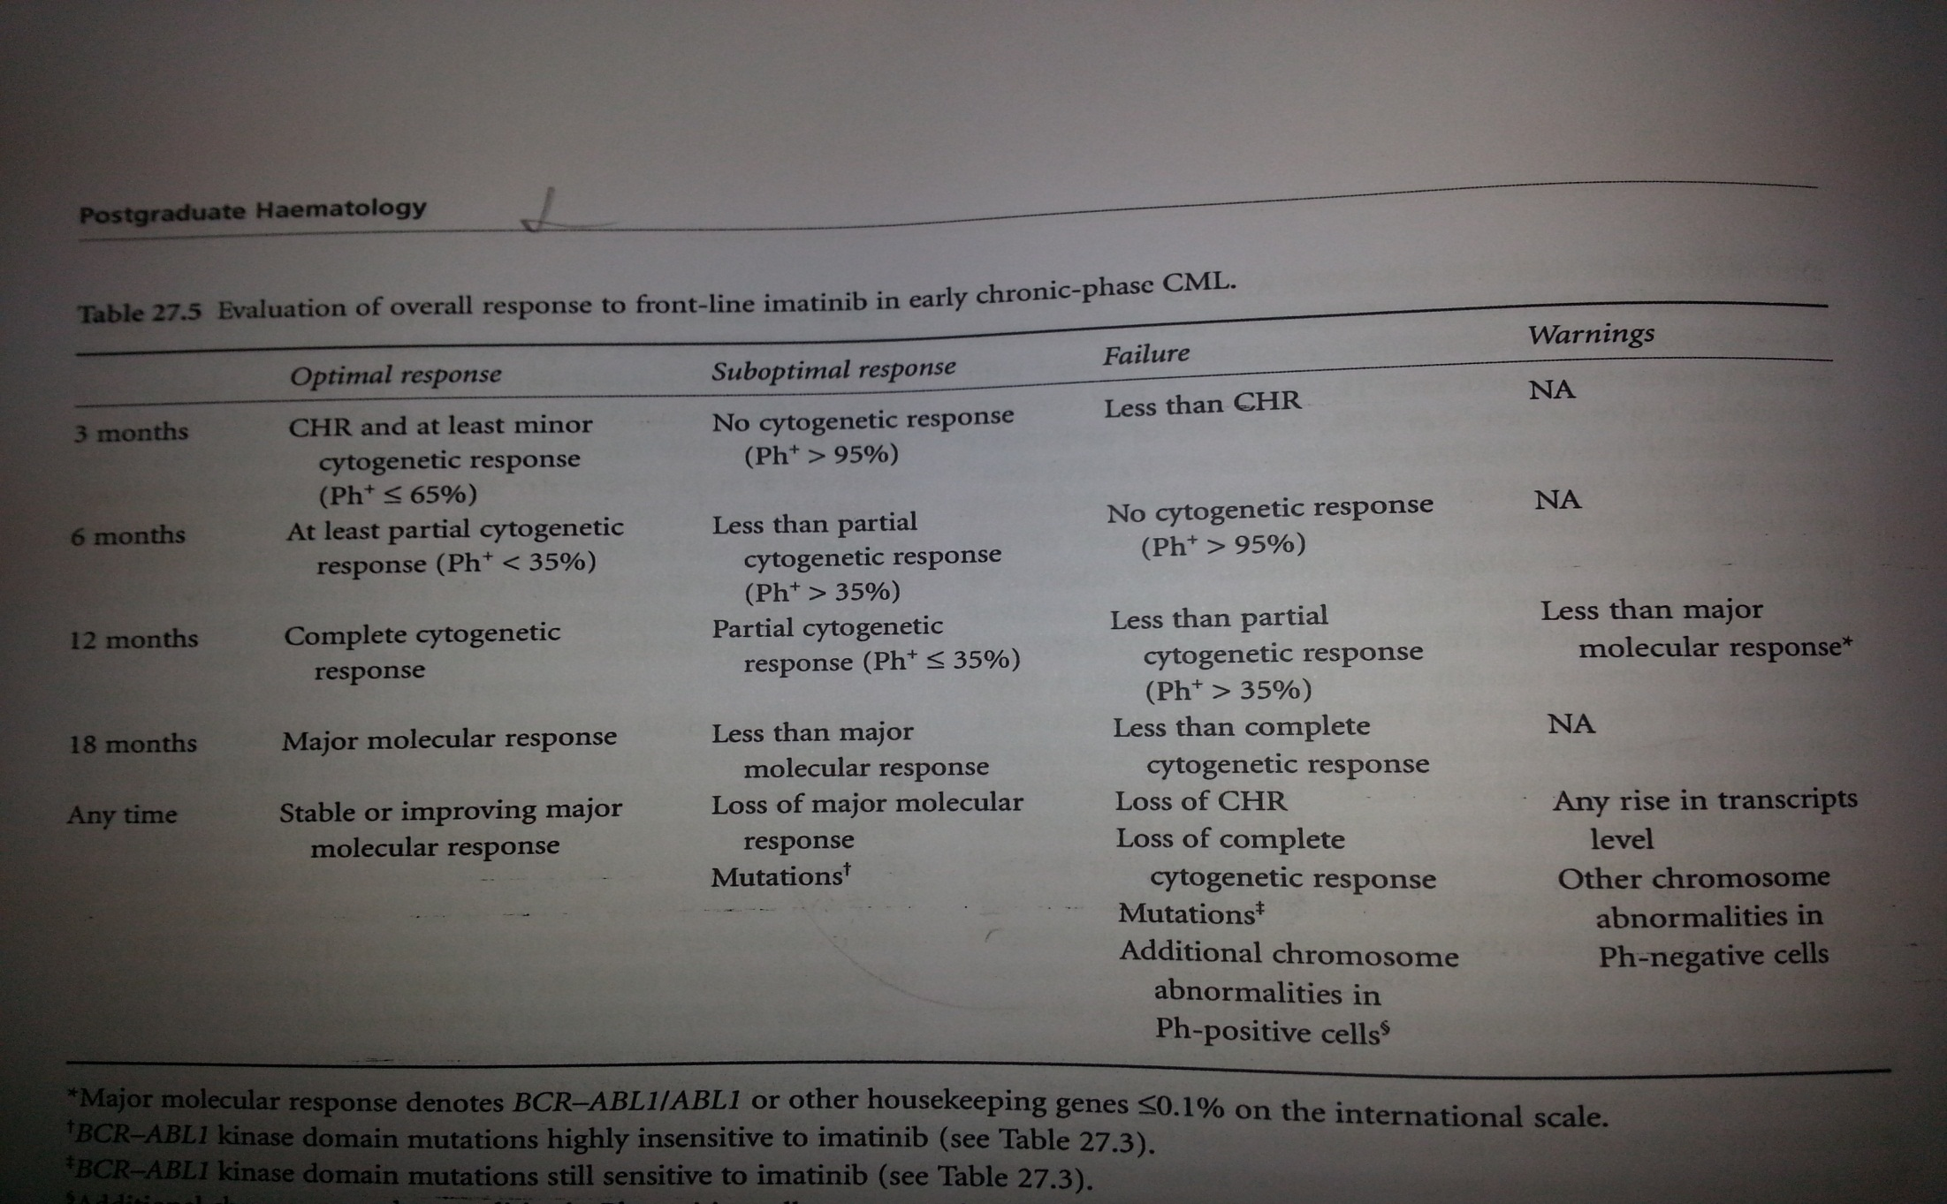
Chronic myeloid leukemia

Slide 18
Chronic myeloid leukemia
Resistance to imatinib
primary or secondary
The cause of primary resistance is essentially unknown
Secondary resistance is poorly defined.
Second generation Tyrosine kinase inhibitors.

Slide 19
Chronic myeloid leukemia
Dasatinib
In 2003
100 mlg once daily
Side effects:
nausea,
gastrointestinal disturbances
Rashes
Plural effusions

Slide 20
Chronic myeloid leukemia
Nilotinib (Tasigna)
30 times more active in vitro
Complete cytogenetic responses in about 50% of
patients who fail imatinib
400 mlg twice daily
Side Effects:
Headaches
Nausea
Gastrointestinal Disturbances
Pancreatitis
Abnormal Liver function
Prolongation of the QT

Slide 21
Chronic myeloid leukemia
Bosutinib
Phase 3 Study
severe Diarreah

Slide 22
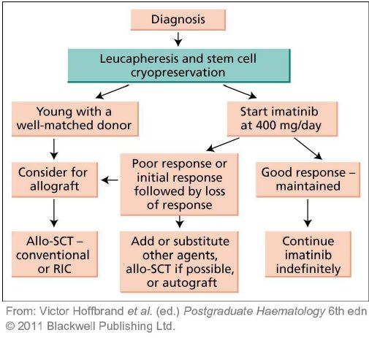
Allogeneic Stem cell transplantation

