Slide 2
Background ______________________________
Only specialist Hemato-Oncology nurses or medical staff who have been assessed competent against local trust protocols for the administration of cytotoxic drugs and have maintained mandatory annual training can administer cytotoxic drugs

Slide 3
Background ______________________________
Senior medical staff are not routinely required to administer IV. Chemotherapy but on request will be offered the same training as nursing staff and will require assessment as competent against local trust protocols. They also need to maintain mandatory annual training.

Slide 4
Guidelines ----------------------------------------------------------------------
Chemotherapy should only be administered in designated areas for administration of chemotherapeutic agents : a) Named area b) during normal working hours ( as far as possible) c) defined area for temporary storage of chemotherapeutic agents

Slide 5
Guidelines --------------------------------------------------------------
All areas in which chemotherapy drugs are administered must have the following equipment:
1- Emergency bell and telephone
2- Resuscitation equipment
3- Drugs for the management of emergencies ( Cardiac arrest and anaphylaxis )
4- Extravasation kit
5- Copies of relevant policies and procedures

Slide 6
Resuscitation Equipment

Slide 7
Exceptional Circumstances in which chemotherapy may be administered in non-designated areas: -----------------------------------------------------------------------------------------
1- Where emergency chemotherapy is required ( ICU where it would be unsafe to move the patient to the designated area )
2- Patients with a performance status of 3 or above
3- When a patient is on another ward and requires chemotherapy

Slide 8
When a patient is on another ward :
- Administration should only be performed by an experienced chemotherapy trained practitioner.
- The practitioner should carry with them to the area an extravasation kit and label indicating cytotoxic agents
- The nurse should stay with the patient throughout
the administration of the chemotherapy .
- The administration should be recorded in the patient’s hospital note.
- All the cytotoxic waste should be disposed of in a designated sharp contents.

Slide 9
The administration of chemotherapeutic agents should not commence or should STOP if :
1- The patient requests the treatment to stop.
2- There is any doubt regarding the stability of the drug , route and method of administration or the prescription is unclear.
3- Unsafe environment.
4- The patient demonstrates side effects or complications
5- There is any doubt regarding the integrity of the venous access device being used .

Slide 10
The administering practitioner must ensure appropriate venous access with regard to : ----------------------------------------------------------------------------------------
Site
Position
Patency
Integrity
Visibility

Slide 11
IV pumps

Slide 12
Cytotoxic Sharp Bin

Slide 13
Extravasation Kit

Slide 14
Contents of extravasation Kit

Slide 15
Management of chemotherapy extravasation ( ESMO guidelines )
Definition
Extravasation is the process by which any liquid ( fluid or drug ) accidentally leaks into the surrounding tissues.
In terms of cancer therapy, extravasation refers to the inadvertent infiltration of chemotherapy into the subcutaneous or subdermal tissues surrounding the intravenous or intra-arterial administration site

Slide 16
Classification of Extravasated drugs
Extravasated drugs are sub-classified into :
Vesicant
Irritant
Non-vesicant
Vesicant drugs are classified into :
DNA binding drugs
Non-DNA Binding drugs

Slide 17
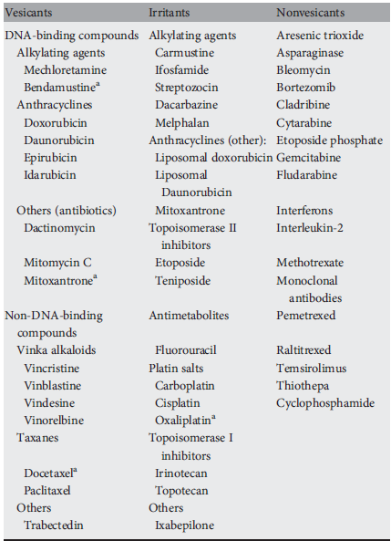

Slide 18
Incidence of Extravasation
Data are scant due to absence of centralized register of extravasation events
Incidence rate : 0.01%-7%
Causes of decreased incidence of extravasation : __________________________________________
1- Improvement in the infusion procedures.
2- Early recognition of drug leakage
3- Training in management techniques

Slide 19
Risk Factors for Extravasation
- Adequate identification of these factors is important to minimize the risk.
- In case of increased risk , preventive measures should be encouraged or even insertion of CV line

Slide 20
Risk Factors for Extravasation
Patient-related factors
Cannulation and infusion procedure related Factors

Slide 21
Patient-Related Factors
1-small and fragile veins
2- Hard and/or sclerosed veins as a consequence of multiple previous chemotherapy courses or drug abuse.
3- Elderly persons ( Prominent but mobile veins )
4- Known diseases or situations associated with an altered or impaired circulation like Raynaud syndrome, advanced diabetes, severe peripheral vascular disease, lymphedema or superior cava syndrome.
5- Predisposition to bleeding, increased vascular permeability or those with coagulation abnormalities
6- Obesity in which peripheral venous access is more difficult.
7- Sensory deficits that impair the patient’s ability to detect a change in sensation at the site of chemotherapy administration.
8- Communication difficulties or young children, which hinder the early reporting of the signs and symptoms allowing the identification of extravasation.
9- Prolonged infusion

Slide 22
Cannulation and Infusion Procedure Related Factors
1- Untrained or inexperienced staff
2-Multiple attempts at cannulation
3- Unfavorable cannulation site
4- Bolus injections
5- High flow pressure
6- Choice of equipment (peripheral catheter choice, size, steel ‘Butterfly’ needle)
7- Inadequate dressings or poor cannula fixation
8- Poorly implanted CVAD (too deep for cannula, difficult to secure cannula)

Slide 23
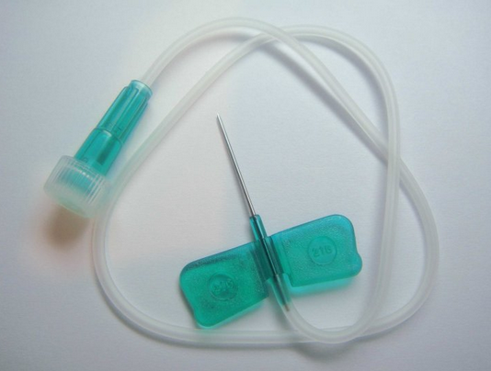

Slide 24
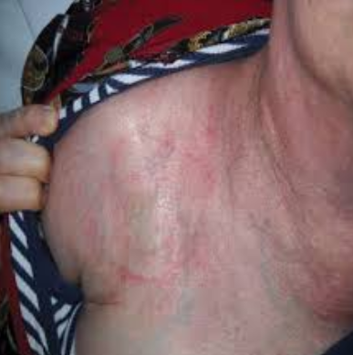

Slide 25
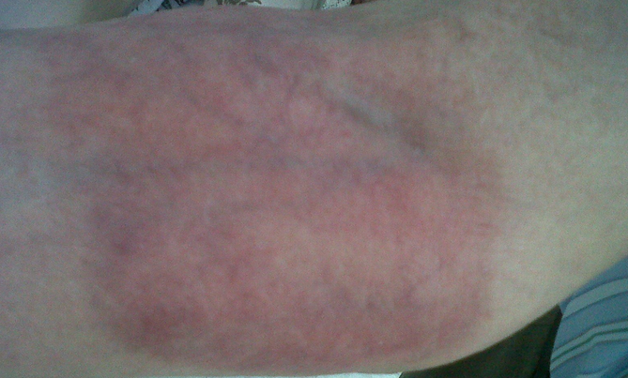

Slide 26
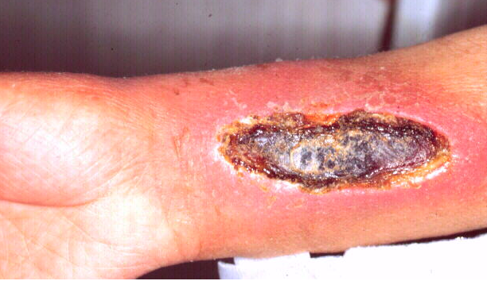

Slide 27
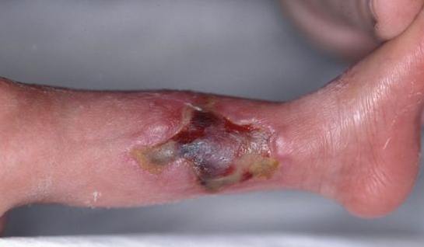

Slide 28
Preventive Measures to minimize the risk of Extravasation

Slide 29
Preventive Measures to minimize the risk of Extravasation

Slide 30
Preventive Measures to minimize the risk of Extravasation

Slide 31
Diagnosis of Extravasation
Symptoms :
feelings of tingling, burning, discomfort/pain or swelling, and redness at the injection site. Later symptoms may include blistering, necrosis and ulceration.
Signs :
the absence of blood return, resistance on the plunger of the syringe during delivery of a bolus drug, or an interruption to the free flow of an infusion.

Slide 32
Management of Extravasation
General Measures
1- patient education
2- Informing the patient.
3-it is highly recommended that every department that administers chemotherapy has trained persons who know what to do in case of extravasation.
4- An extravasation kit containing instructions, materials and medication to handle any incidence should be always available.
5- An early multidisciplinary evaluation by nurses, medical oncologists and surgeons is recommended.
Specific Measures
1- multiple subcutaneous injections
of hydrocortisone followed with topical betamethasone prevented tissue necrosis or sloughing necessitating surgical treatment.
2- Sodium thiosulphate
3- Dimethyl Sulphoxide ( DMSO )
4- Dexazoxane ( In case of Anthracyclines )

Slide 33
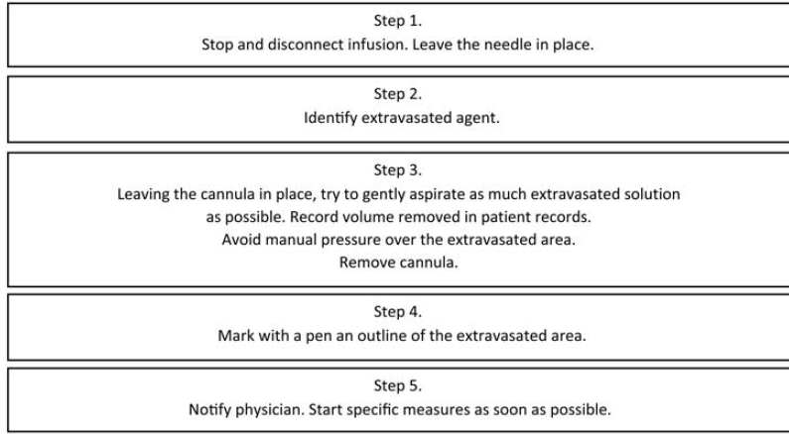

Slide 34
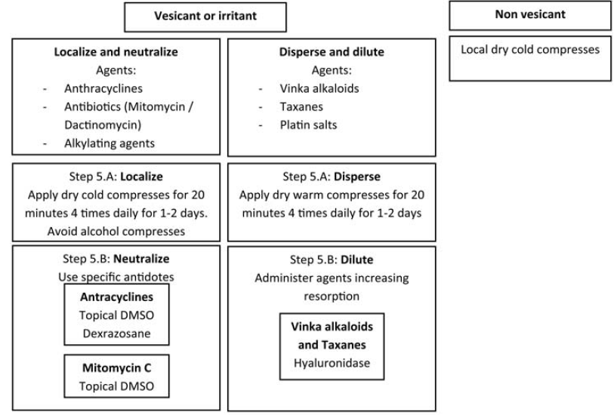

Slide 35
Extravasation Kit

Slide 36
Contents of extravasation Kit

Slide 37
Documentation

Slide 38
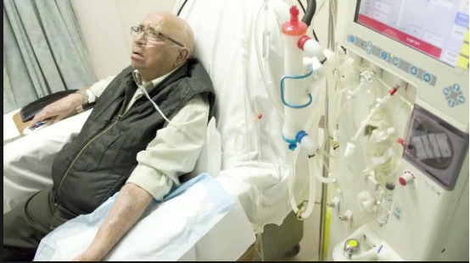

Slide 39
